Slide 1


Slide 2
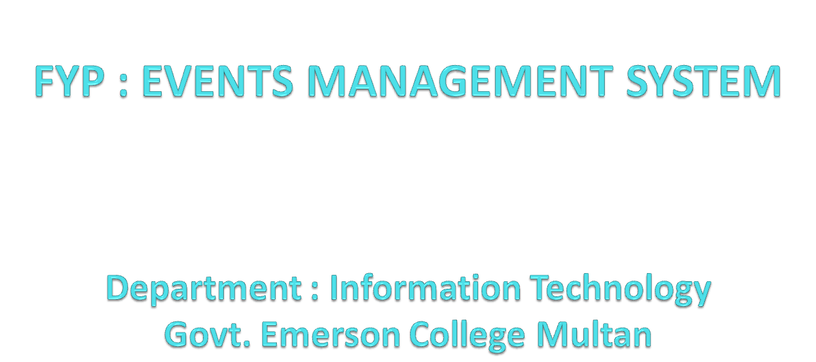

Slide 3
Name : M. Ejaz Awan
Roll no : MCE-IT-1104
Supervisor : Mr. Asif Raza

Slide 4
Agenda
Introduction
Purpose
Process Model
Process Flow Diagram
Project Schedule
FRs + NFRs
Use Cases
Use Case Diagram
ERD

Slide 5
Agenda
Database Design
Sequence Diagram
Class Diagram
Mapping
Tools
GUIs
Test Cases

Slide 6
Introduction
Event management is becoming a very popular profession
Event Management System is a system in which events are managed and organized.
Events are updated on day to day basis. Big Companies or Institutes who want to get attention of the people can use this system.

Slide 7
Contd…
Nowadays there is a huge growth of festivals and events in the society so event management is very necessary.
It provides platform for users to see the events. This system will give users the complete information of events.

Slide 8
Purpose
The main purpose is to design an information system for scheduling events. The events will be of different categories and the users can select particular category of event which they want and attend it. As we know some people are not able to see the events in time. They see the event when the date of an event is passed. This system allows them to check and search the social events in time. People will be well aware of what is happening in the society around them. They do not need to read the newspapers or watching ads on the TV; they can just use this system and can participate in the event.

Slide 9
Scope
This system covers the events of only those Event Organizers who are willing to post their event on this website. Event Organizers/Advertisers who are willing to post their event have to registers themselves so that they can post event. Event Organizers after login have to select category and location before posting their event. Admin can include the new event category of Event Organizer/Advertiser if it is not listed or displayed in the website. Event Organizers can make changes to their event which they have posted. Users who want to participate in the events can use this system and can participate in the event.

Slide 10
Contd…
By selecting an event, user can get complete detail of the event such as:
Event Title
Event Category
Event Location
Event Date and Time
Event Organizer
Event Description

Slide 11
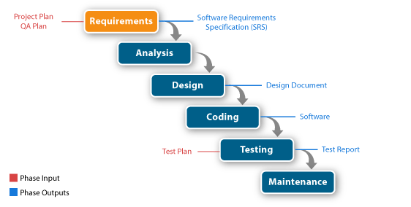
Process Model
Process Model Used: Water Fall Model
Reasons: Clear Requirements, Plenty of time, Simple nature of Project

Slide 12
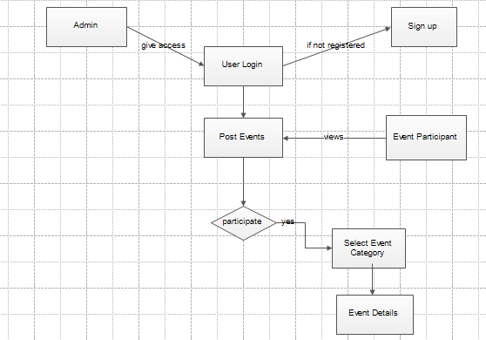
Process Flow Diagram

Slide 13
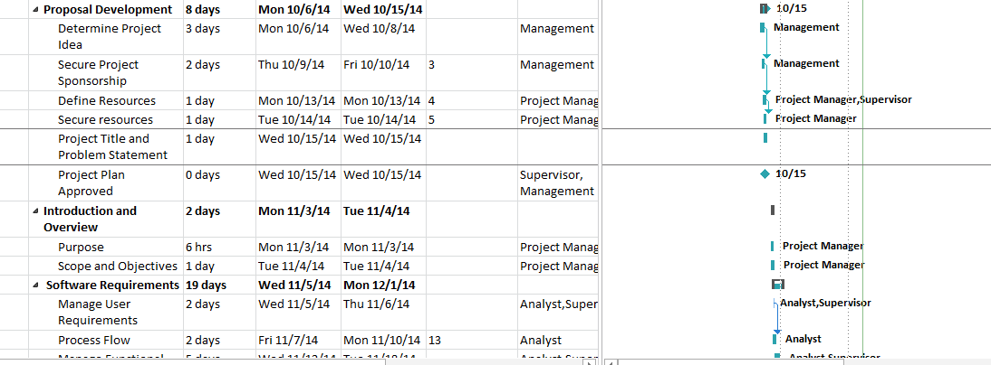
Project Schedule

Slide 14
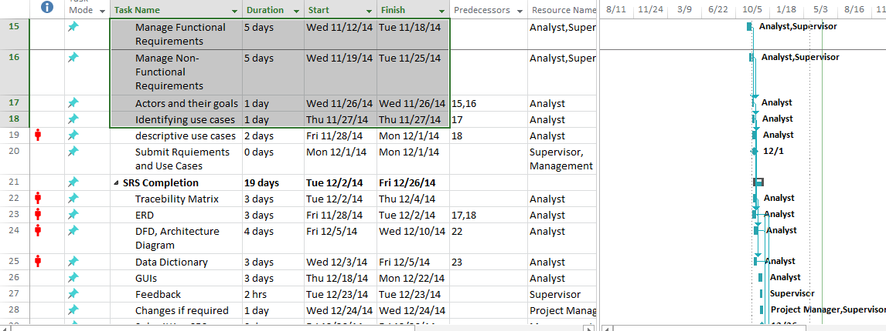
Project Schedule

Slide 15
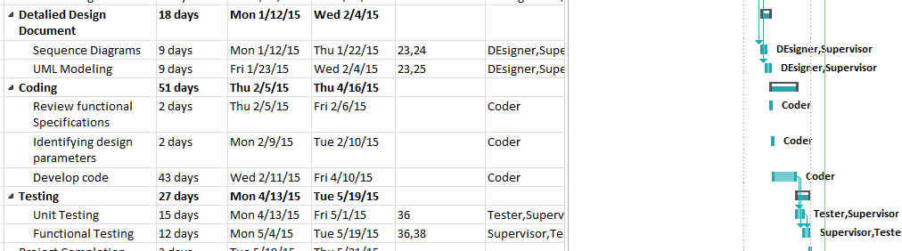
Project Schedule

Slide 16
Functional Requirements
FR No | Requirement
FR01 | User/ Event Organizer Login
FR02 | Sign up for unregistered users
FR03 | Post Events
FR04 | Edit Events
FR05 | Delete Events
FR06 | View Events
FR07 | Search Events
FR08 | User’s Participation
FR09 | Account Deletion

Slide 17
Non-Functional Requirements
NFR No | Requirement
NFR01 | Performance
NFR02 | Security
NFR03 | Availability
NFR04 | Usability
NFR05 | Readabilty

Slide 18
Use Cases
Here is the list of use cases that are used:
Login
Signup
Post Events
Search Events
Edit Events
Delete Events
Join Events
Logout

Slide 19
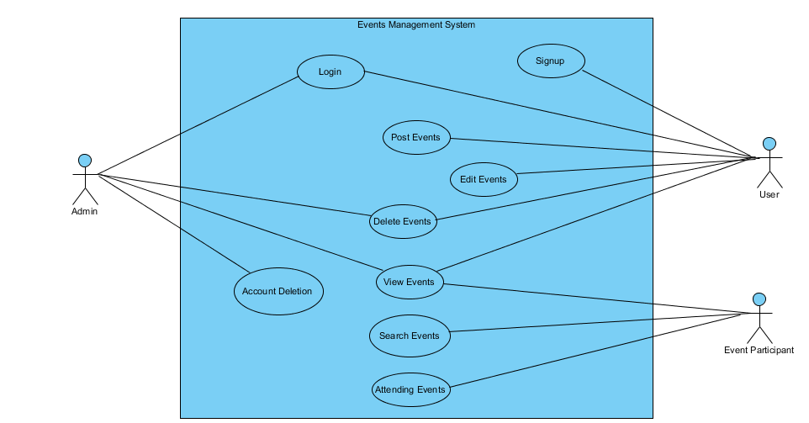

Slide 20

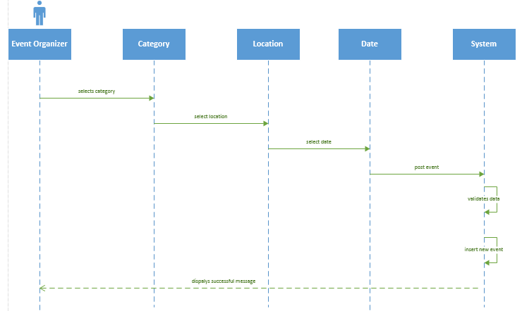

Slide 21

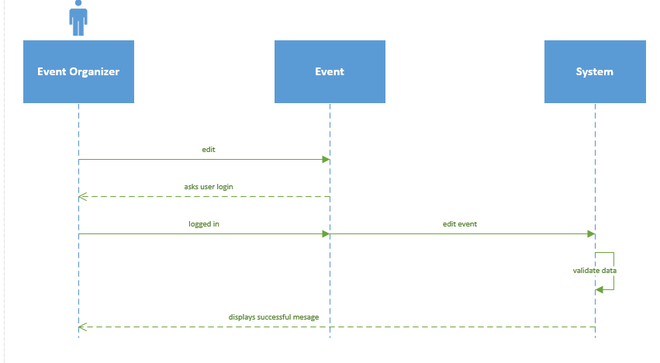

Slide 22

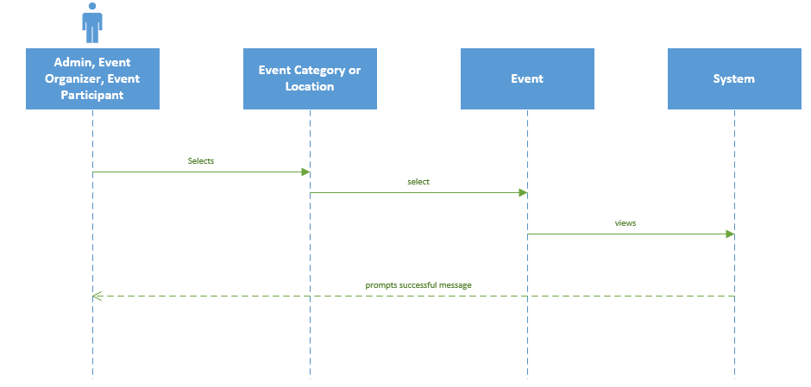

Slide 23

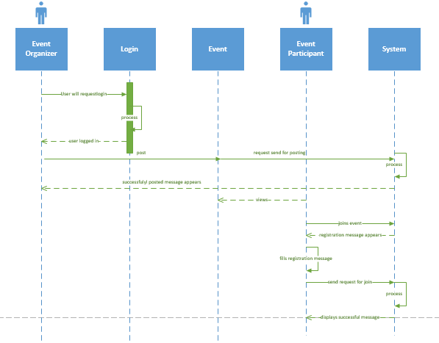

Slide 24
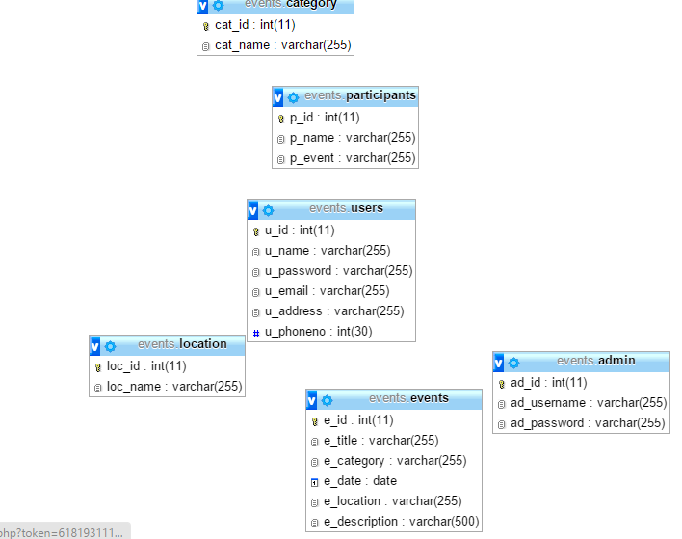
Database Design

Slide 25
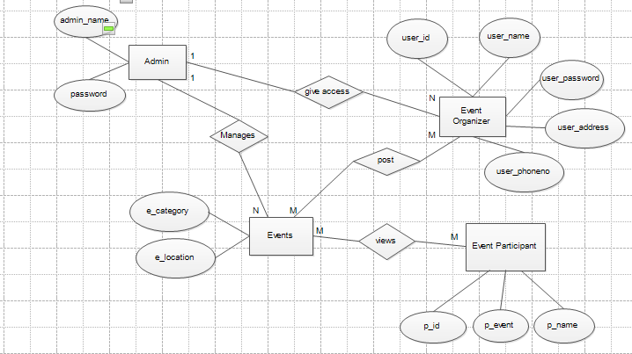
Entity-Relationship Diagram

Slide 26
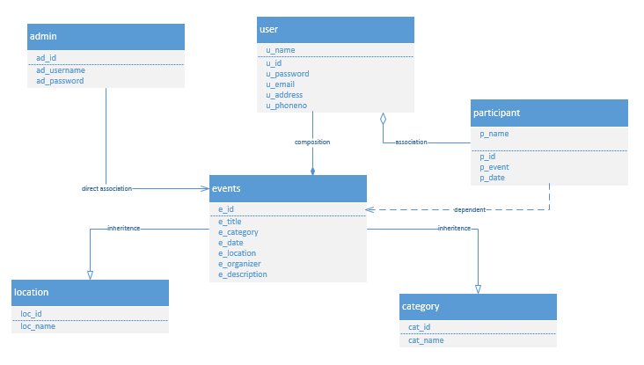
Class Diagram

Slide 27
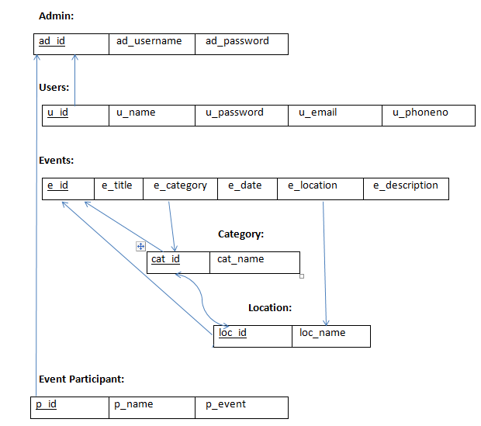
Mapping from ER TO RELATIONAL MODEL

Slide 28
Tools and Techniques
HTML 5, PHP, CSS, Javascript
MySQL Server
Wamp Server/ Easy Php Server
Visual Paradigm
Edraw
Microsoft Word

Slide 29

Provide screen shots of GUI in different slides of your application here

Slide 30
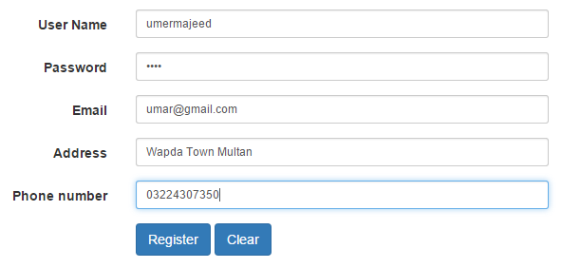
New User registered

Slide 31
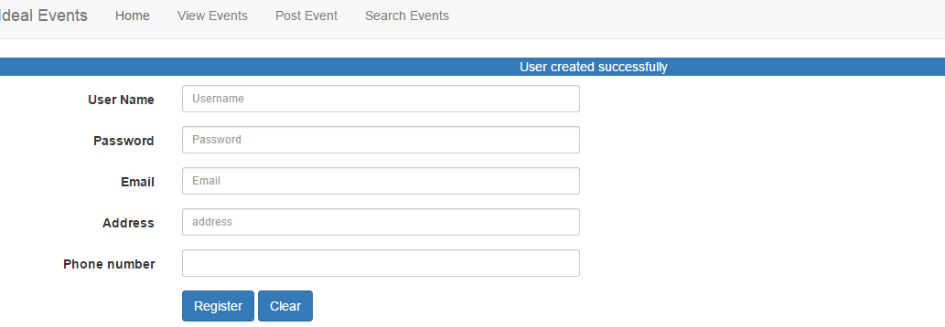
User Register

Slide 32
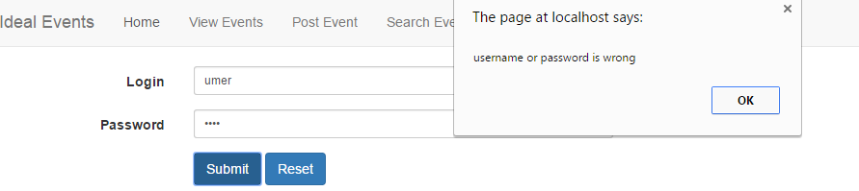

Slide 33
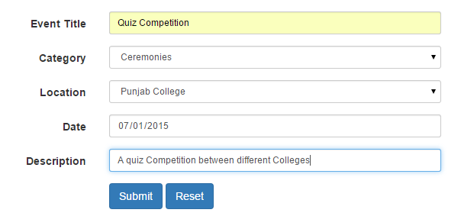

Slide 34
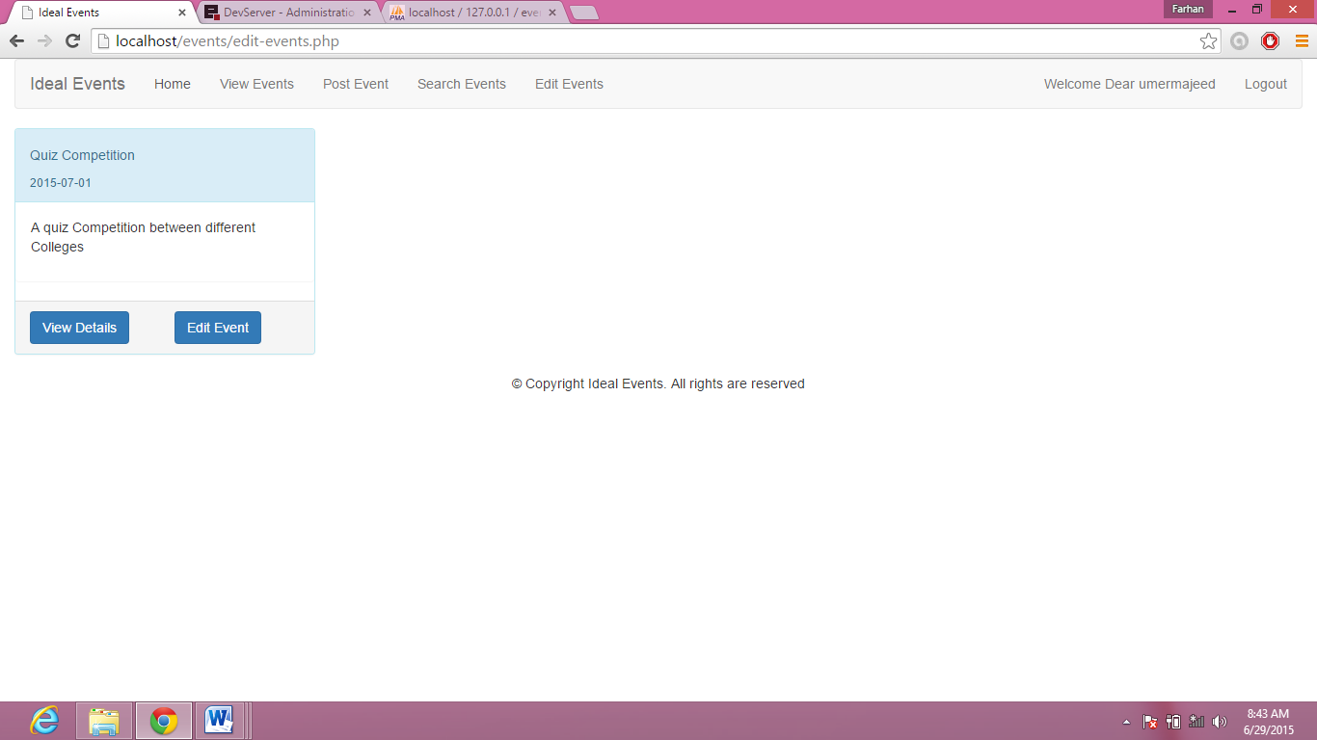

Slide 35
Test Cases
Test Case : Login
Test case ID | Pre-conditions | Action/inputs | Expected result | Test result
1 | User click on the Login button and Login form appears | User enter the incorrect username and password correct | When user clicks on the login button system must prompt alert message that user must enter correct username. | Pass
2 | User click on the Login button and Login form appears | User enter the username correct but empty the password | When user clicks on the login button system must prompt alert message that all fields must be filled. | Pass
3 | User click on the Login button and Login form appears | User enter the username correct but enter password incorrect | When user clicks on the login button system must prompt alert message password does not match. | Pass

Slide 36
Test Cases
Test Case : Signup
Test case ID | Pre-conditions | Action/inputs | Expected result | Test result
1 | User click on the Register button if he does not have account | User do not fill all the required fields | Users get alert message that fill all fields | Pass

Slide 37
Test Cases
Test Case : Post Events
Test case ID | Pre-conditions | Action/inputs | Expected result | Test result
1 | User click on the Post event button and event entry form appears | User submit the post event form | When user clicks on submit button system must prompt message that user must have to register | Pass
2 | User click on the Post event button and event entry form appears | User enter the same location that already reserved | When user clicks on submit button system must prompt message that location reserved | Pass

Slide 38
Test Cases
Test Case : Edit Events
Test case ID | Pre-conditions | Action/inputs | Expected result | Test result
1 | User click on the Edit Events hyperlink and edit events page appears | User edit the events information | When user click on submit button system will return successful message. | Pass
2 | User click on the Edit Events hyperlink and edit events page appears | User has not posted an event | When user click on edit event button system shall display error. | Pass

Slide 39
References
www.w3schools.com
www.stackoverflow.com
www.yourwebskills.com

Slide 40


Slide 41


